Slide 1
Subject and Subject Code:PCS8N201
ONLINE CAR RENTAL SYSTEM
Submitted in partial fulfillment of the requirements of the degree of
Bachelor of Technology(B.Tech)
Biju Patnaik University of Technology
Department of Computer Science Engineering
Gandhi Institute For Technology(GIFT), Bhubaneswar
Name of the Student | Registration No
Bharadwaj Nayak | 1901298095
Sahil Kumar Dhala | 1901298183
Satya Sunder Moharana | 1901298192
Group No: 12
Mr. Priyabrata Nayak
Asst. Prof. of CSE
Dr. Satya Ranjan Pattnaik
Head of the Department
CSE

Slide 2
Table of Contents
Motivation
Literature Review
Research Gap
Objective
Scope of the project
Methodology- Experimental/Numerical
Abstract
Introduction
Result and Discussion
Conclusion
Future Scope
Reference
Publication

Slide 3
ABSTRACT
The online car rental system aims to design and create a data management system for an online car rental company. This system enables the admin to efficiently manage rental bookings, customer issues, vehicle information, and transaction reports. By centralizing and organizing data, the system ensures quick and easy access to relevant information, enhancing operational efficiency.
The online car rental system was developed using the Software Development Life Cycle (SDLC) methodology, specifically the waterfall model. This approach ensures a systematic and structured development process, resulting in a robust and reliable software solution. The SDLC methodology includes various stages, such as requirements gathering, design, development, testing, and deployment, ensuring a comprehensive and well-executed system.
The online car rental system provides a streamlined process for customers to reserve vehicles. With a user-friendly interface, customers can effortlessly browse available cars, select their desired model, and make instant bookings with just a few clicks

Slide 4
MOTIVATION
One of the primary motivations is to provide customers with a convenient and accessible platform to rent vehicles. By offering an online system, customers can easily browse available cars, make reservations, and manage their bookings from anywhere at any time, eliminating the need to visit physical rental locations or make phone calls.
For car rental companies, implementing an online system increases operational efficiency. Automation of processes such as booking management, vehicle availability tracking, and payment processing minimizes manual effort and reduces the potential for errors. This improved efficiency translates into better utilization of resources and faster response times to customer requests..
online car rental systems is to centralize and manage rental data effectively. By storing information about vehicles, bookings, customer details, and transactions in a structured database, rental companies can access real-time data, generate reports, and gain valuable insights for business decision-making and performance evaluation.

Slide 5
INTRODUCTIONS
An online car rental system is web based on application .
It’s allows a person to book/reserve a vehicle with payment on one end while the company staff handles the transactions.
Online Car Rental Systems are used mostly in developed countries such as England and Australia where electronic commerce has been fully accepted in the society.
Famous companies such as Europcar from United Kingdom, has gained popularity since the business used the technologies available to expand and provide more facilities to their customers.

Slide 6
LITERATURE REVIEW
Reference | Objective | Methology | Conclusion
[1] | The aim of this model evaluation through the bootstrapping menu also generates T-statistics values that will be used to test the hypothesis. The indicator can be used to confirm that the indicator can together with other indicators explain a latent variable | WEB BASED, Structural Equation Modeling (SEM) with SMART PLS software. | The results show the level of community knowledge of smartphone features obtained through Asking more effectively to know the features of a smartphone than with a self-learning approach
[2] | The aim of this research is solving the problems that occur in Avis Indonesia; propose development of web-based car rental management information system. | SDLC,WEB BASED,XAMPP | With web-based car rental management information system, could improve the time efficiency of rental history data transmission after using this application.

Slide 7
Reference | Objective | Methology | Conclusion
[3] | The main purpose of developing SMS-based content alert for car rental system is to reduce the cost and time consumed, which is beneficial to the car rental agencies and customers. Therefore, the system was designed automatically to send an alert SMS to the customers about the availability of the car reserved. | Web-based system, SMS technology, SDLC | The integration of web-based and SMS technology in the car rental agencies is the best way to take the advantages of today technology, in order to enhance the productivity and efficiency of organization.
[4] | Car Rental as a Form of Tourism, And the variety of sizes of their vehicles, car rental agencies may also renting vans or trucks, and in certain markets other types of vehicles such as motorcycles or scooters may also be offered. | Google Analytics Tracking Code (GATC), Google Analytics (GA) | The Google Analytics is a very important tool for assessing a large amount of information about people interested in a specific service. Goals are useful because they enable both the measure of a site’s success and failure when people start a funnel and don’t complete it. But they also enable the segmentation of success and in Google Analytics

Slide 8
RESEARCH GAPS
Limited research on user satisfaction: There is a research gap in understanding the factors that contribute to user satisfaction in online car rental systems, including interface design, ease of use, and customer support.
Lack of research on fraud prevention: There is a need for further investigation into effective fraud prevention measures in online car rental systems, such as identity verification, secure payment systems, and fraud detection algorithms.
Insufficient research on personalized recommendations: The research gap lies in exploring personalized recommendation algorithms that can suggest suitable vehicles to customers based on their preferences, previous rental history, and other relevant factors.

Slide 9
OBJECTIVES
The main objective of the Car Rental System is to manage the details of Car, Payment, Customer.
Convenience: You can get to your destination way easier and quicker than when you use public transportation.
Flexibility: Just drive your car whenever you need and go wherever want. You don’t need to wait for the exact buses and adapt the schedules. Moreover, the GPS technology will make your journey even better - it will be your best guide in route.
Additional services: Most of the rental companies provide additional services making your experience even better and more comfortable. (such as extra equipment, door to door delivery, transfers, group tours etc.)

Slide 10
SCOPES of project
The main scope of the online car rental system includes providing a user-friendly platform for customers to browse and book rental vehicles, simplifying the entire booking process and improving customer convenience.
The system's scope encompasses effective management of rental operations, including vehicle inventory, booking management, customer issues, and transaction reporting, optimizing resource allocation and enhancing overall operational efficiency.

Slide 11
METHODOLOGY
Requirement Gathering: The initial step involves gathering the requirements for the system, including functionalities, user interfaces, and operational needs, by consulting with stakeholders and potential users.
System Design: Based on the gathered requirements, the system is designed, encompassing database design, user interface design, and overall system architecture, ensuring a comprehensive and user-friendly solution.
Development and Testing: The system is then developed according to the design specifications, employing programming languages and frameworks. Thorough testing is conducted to identify and resolve any bugs or issues before the system is deployed.
Deployment and Maintenance: Once development and testing are complete, the system is deployed to a production environment, making it accessible to users. Ongoing maintenance and updates are performed to ensure system stability, security, and continuous improvement.

Slide 12
SOFTWARE REQUIREMENTS
User Interface Design : HTML 5, CSS 3, Bootstrap
Software : XAMPP server
Language Used : PHP
Database : MY SQL
Web Browser : Google Chrome, Mozilla

Slide 13
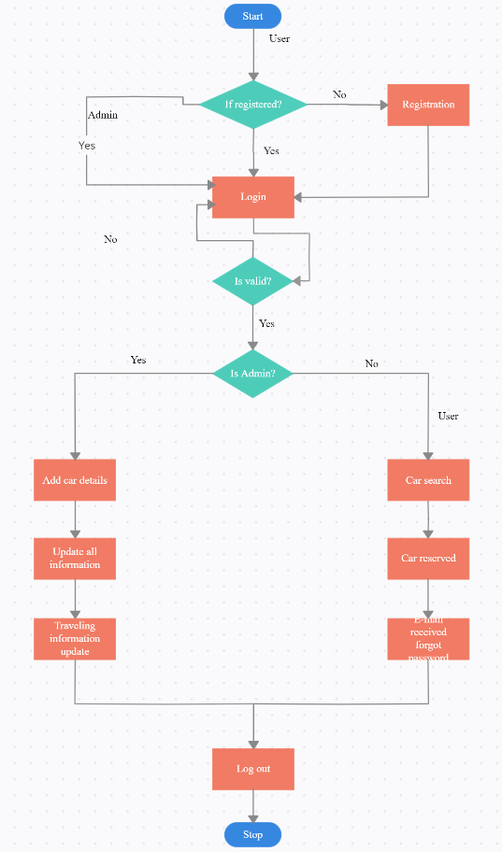
FLOW CHART DIAGRAM

Slide 14
RESULTS
Improved customer satisfaction: The implementation of the online car rental system resulted in increased customer satisfaction due to the convenience and accessibility it offered, allowing users to easily search for and book vehicles according to their preferences and needs.
Enhanced operational efficiency: The online car rental system improved operational efficiency for rental companies by automating processes such as booking management, vehicle availability tracking, and payment processing. This led to reduced manual effort, faster response times, and better resource utilization.
Cost savings for customers: The online car rental system provided cost savings for customers through competitive pricing, promotions, and the ability to compare prices across multiple rental companies. This resulted in increased value for money and improved affordability for renting vehicles.

Slide 15
FUTURE SCOPS
Integration of autonomous vehicles: The future scope of online car rental systems includes the integration of autonomous vehicles, allowing customers to rent self-driving cars for their transportation needs, providing a new level of convenience and flexibility.
Expansion of electric and eco-friendly vehicle options: Online car rental systems have the potential to promote the use of electric and eco-friendly vehicles, contributing to sustainable transportation. The future may see a wider range of electric vehicle options available for rental, encouraging environmentally conscious choices.
Incorporation of advanced technologies: The future of online car rental systems may involve the integration of advanced technologies such as artificial intelligence, machine learning, and data analytics. These technologies can enhance various aspects, including personalized recommendations, predictive maintenance, and efficient fleet management.

Slide 16
CONCLUSION
The website will store any information the user may input when making a rental purchase request.
This will appear in real time onto the software used by the employees.
This software provides an easy-to-use interface to allow for simple access to rental requests and customer information..
The website is designed to stay up to date by giving administrators the ability to change/add/remove any featured vehicles on the site.
In conclusion, the online car rental system offers a secure and efficient platform for customers to make rental requests, provides real-time access to information for employees, offers an intuitive user interface, and allows administrators to easily update and manage featured vehicles on the website.

Slide 17
REFERENCE
Marhayanie, M., Ismail, M., & Muda, I. (2018, January). Impact of Smartphone Features on" Omset" Services Online Car Rental. In 1st Economics and Business International Conference 2017 (EBIC 2017) (pp. 278-281). Atlantis Press.
Waspodo, B., Aini, Q., & Nur, S. (2011). Development of car rental management information system. In Proceedings of The 1st International Conference on Information Systems For Business Competitiveness (ICISBC) (pp. 101-105)..
Osman, M. N., Zain, N. M., Paidi, Z., Sedek, K. A., NajmuddinYusoff, M., & Maghribi, M. (2017). Online car rental system using Web-Based and SMS technology. Computing Research & Innovation (CRINN), 2, 277.
Danila, D. M., & Gaceu, L. (2010). Online Evaluation Method for Assessing the Variation of the Number of Tourists Interested In Car Rental. Bulletin of the Transilvania University of Brasov. Series II: Forestry• Wood Industry• Agricultural Food Engineering, 75-78.
Nasr, O. A., Miladi, M. N., & Ahmed, M. (2020). CAR RENTAL AND TRACKING WEB-BASED SYSTEM USING GPS. IJISCS (International Journal of Information System and Computer Science), 4(2), 63-70.

Slide 18
THANK YOU

